Slide 1
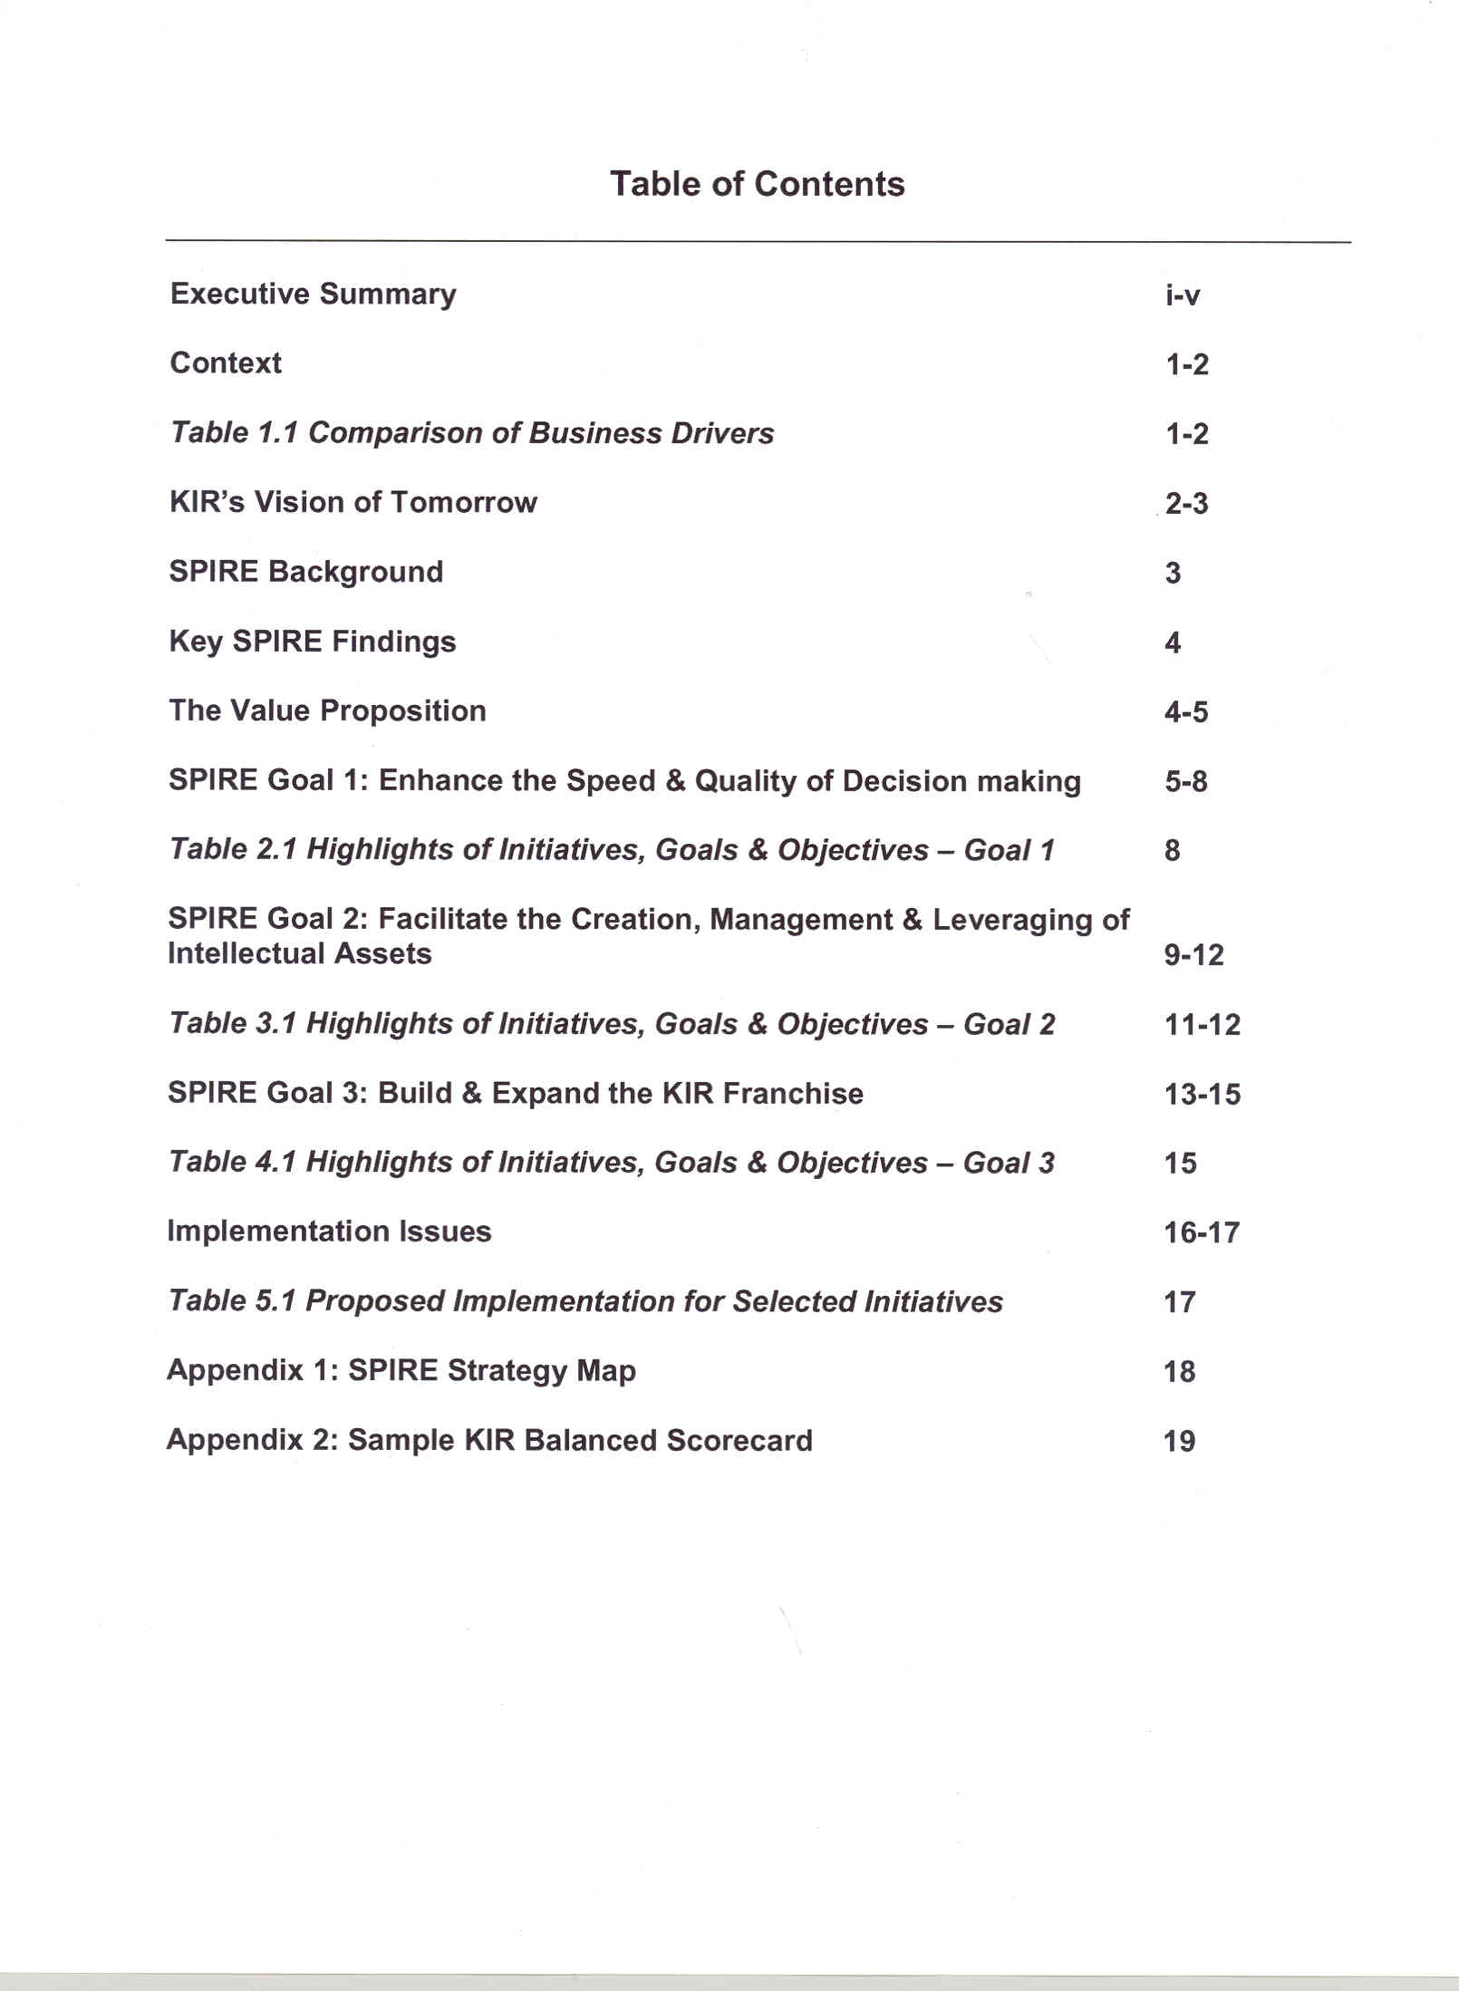
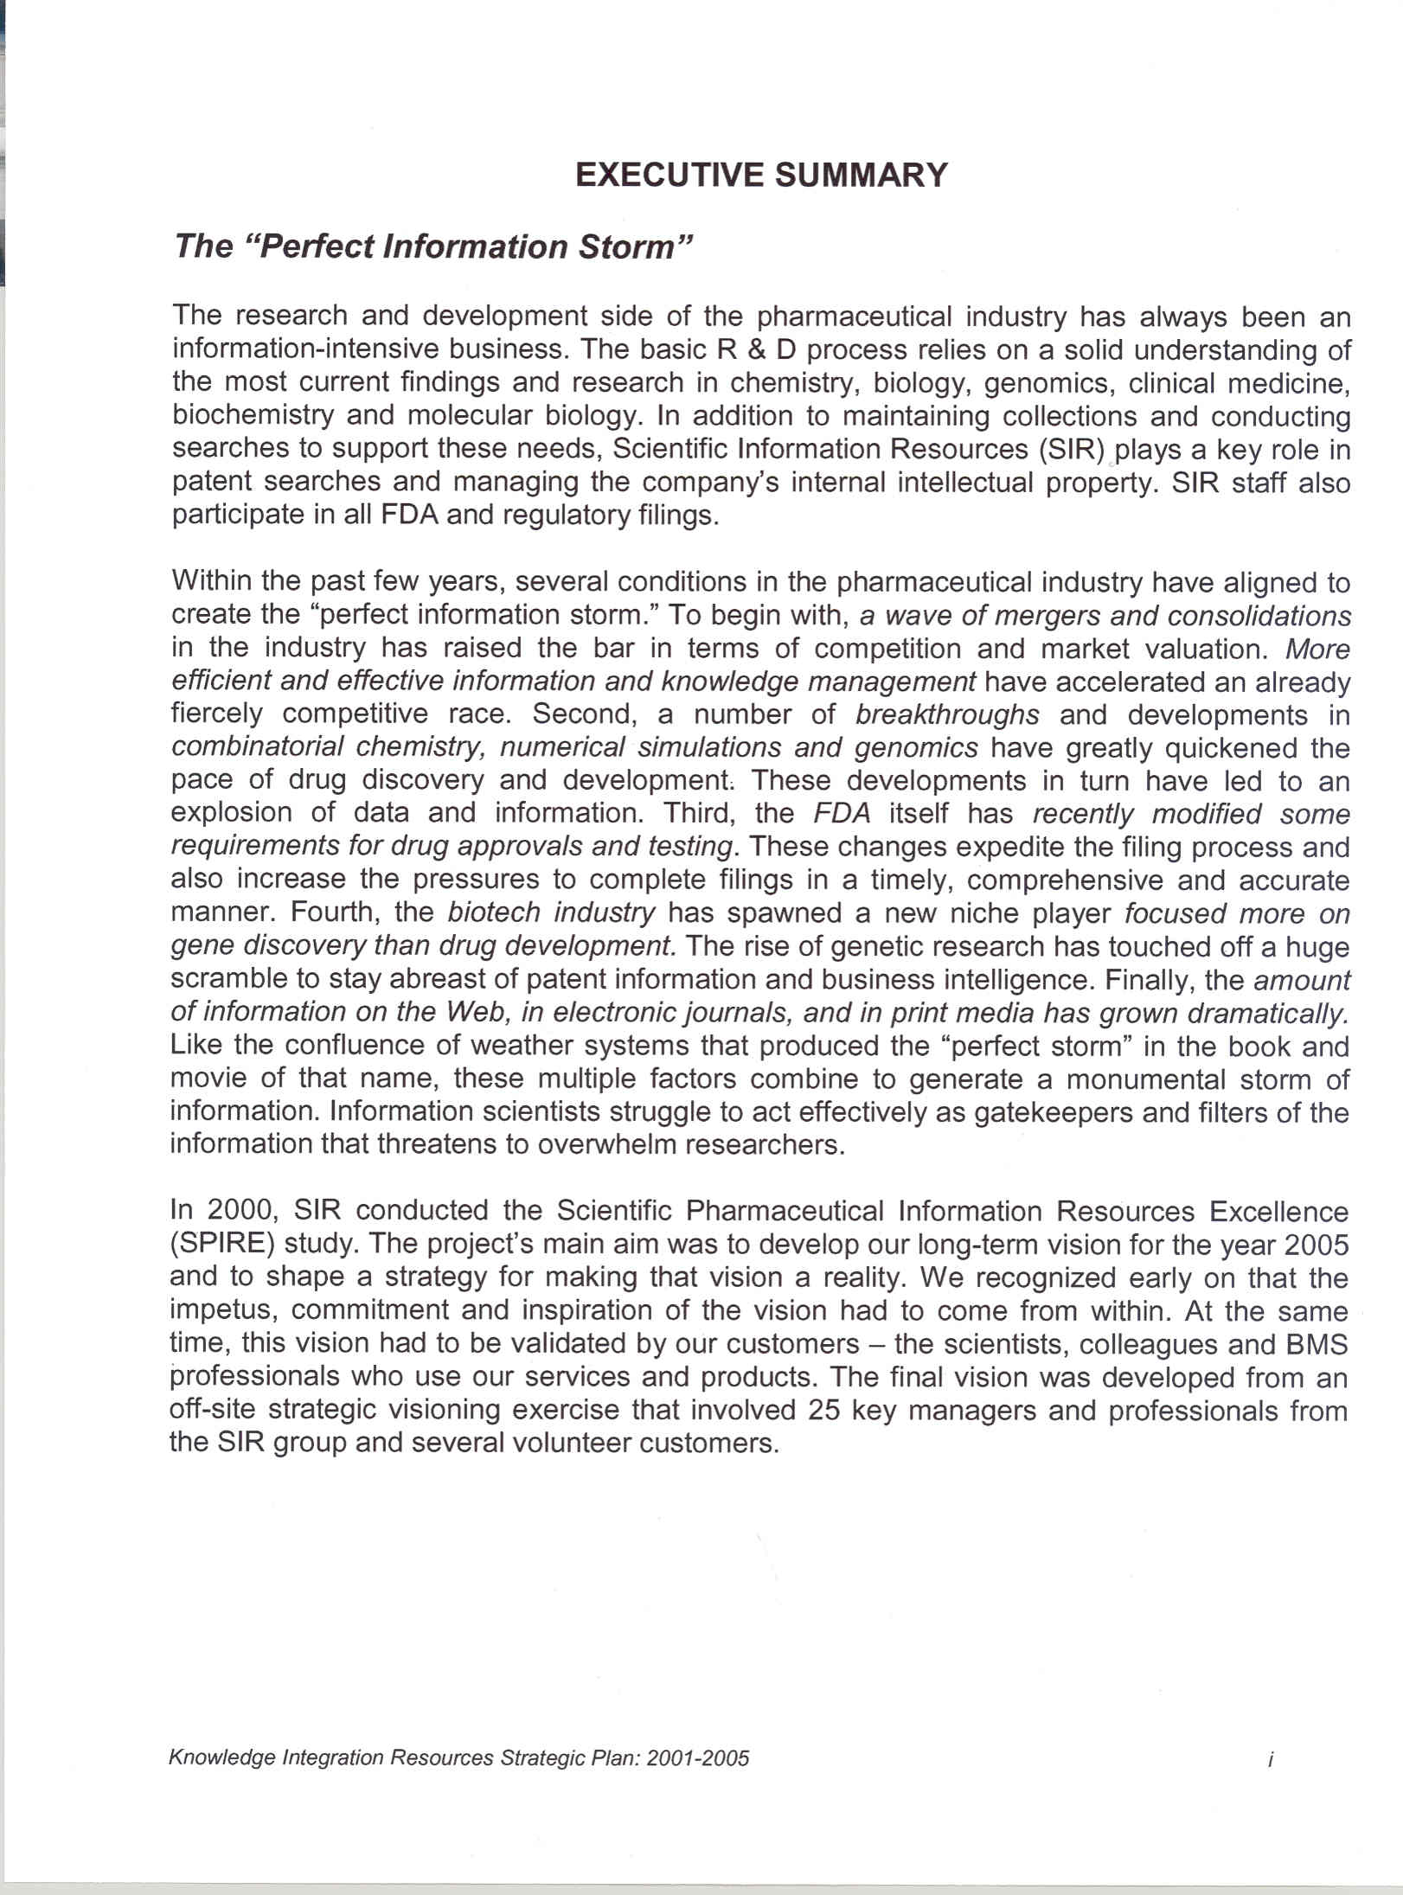
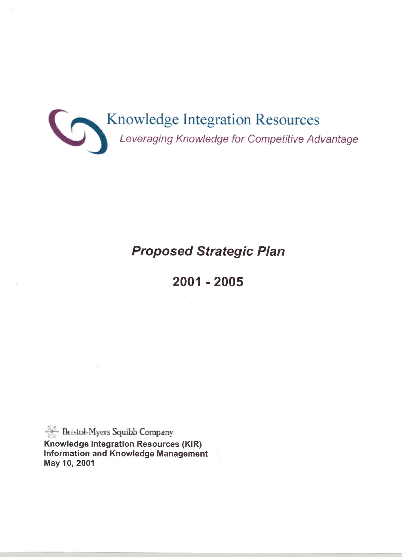
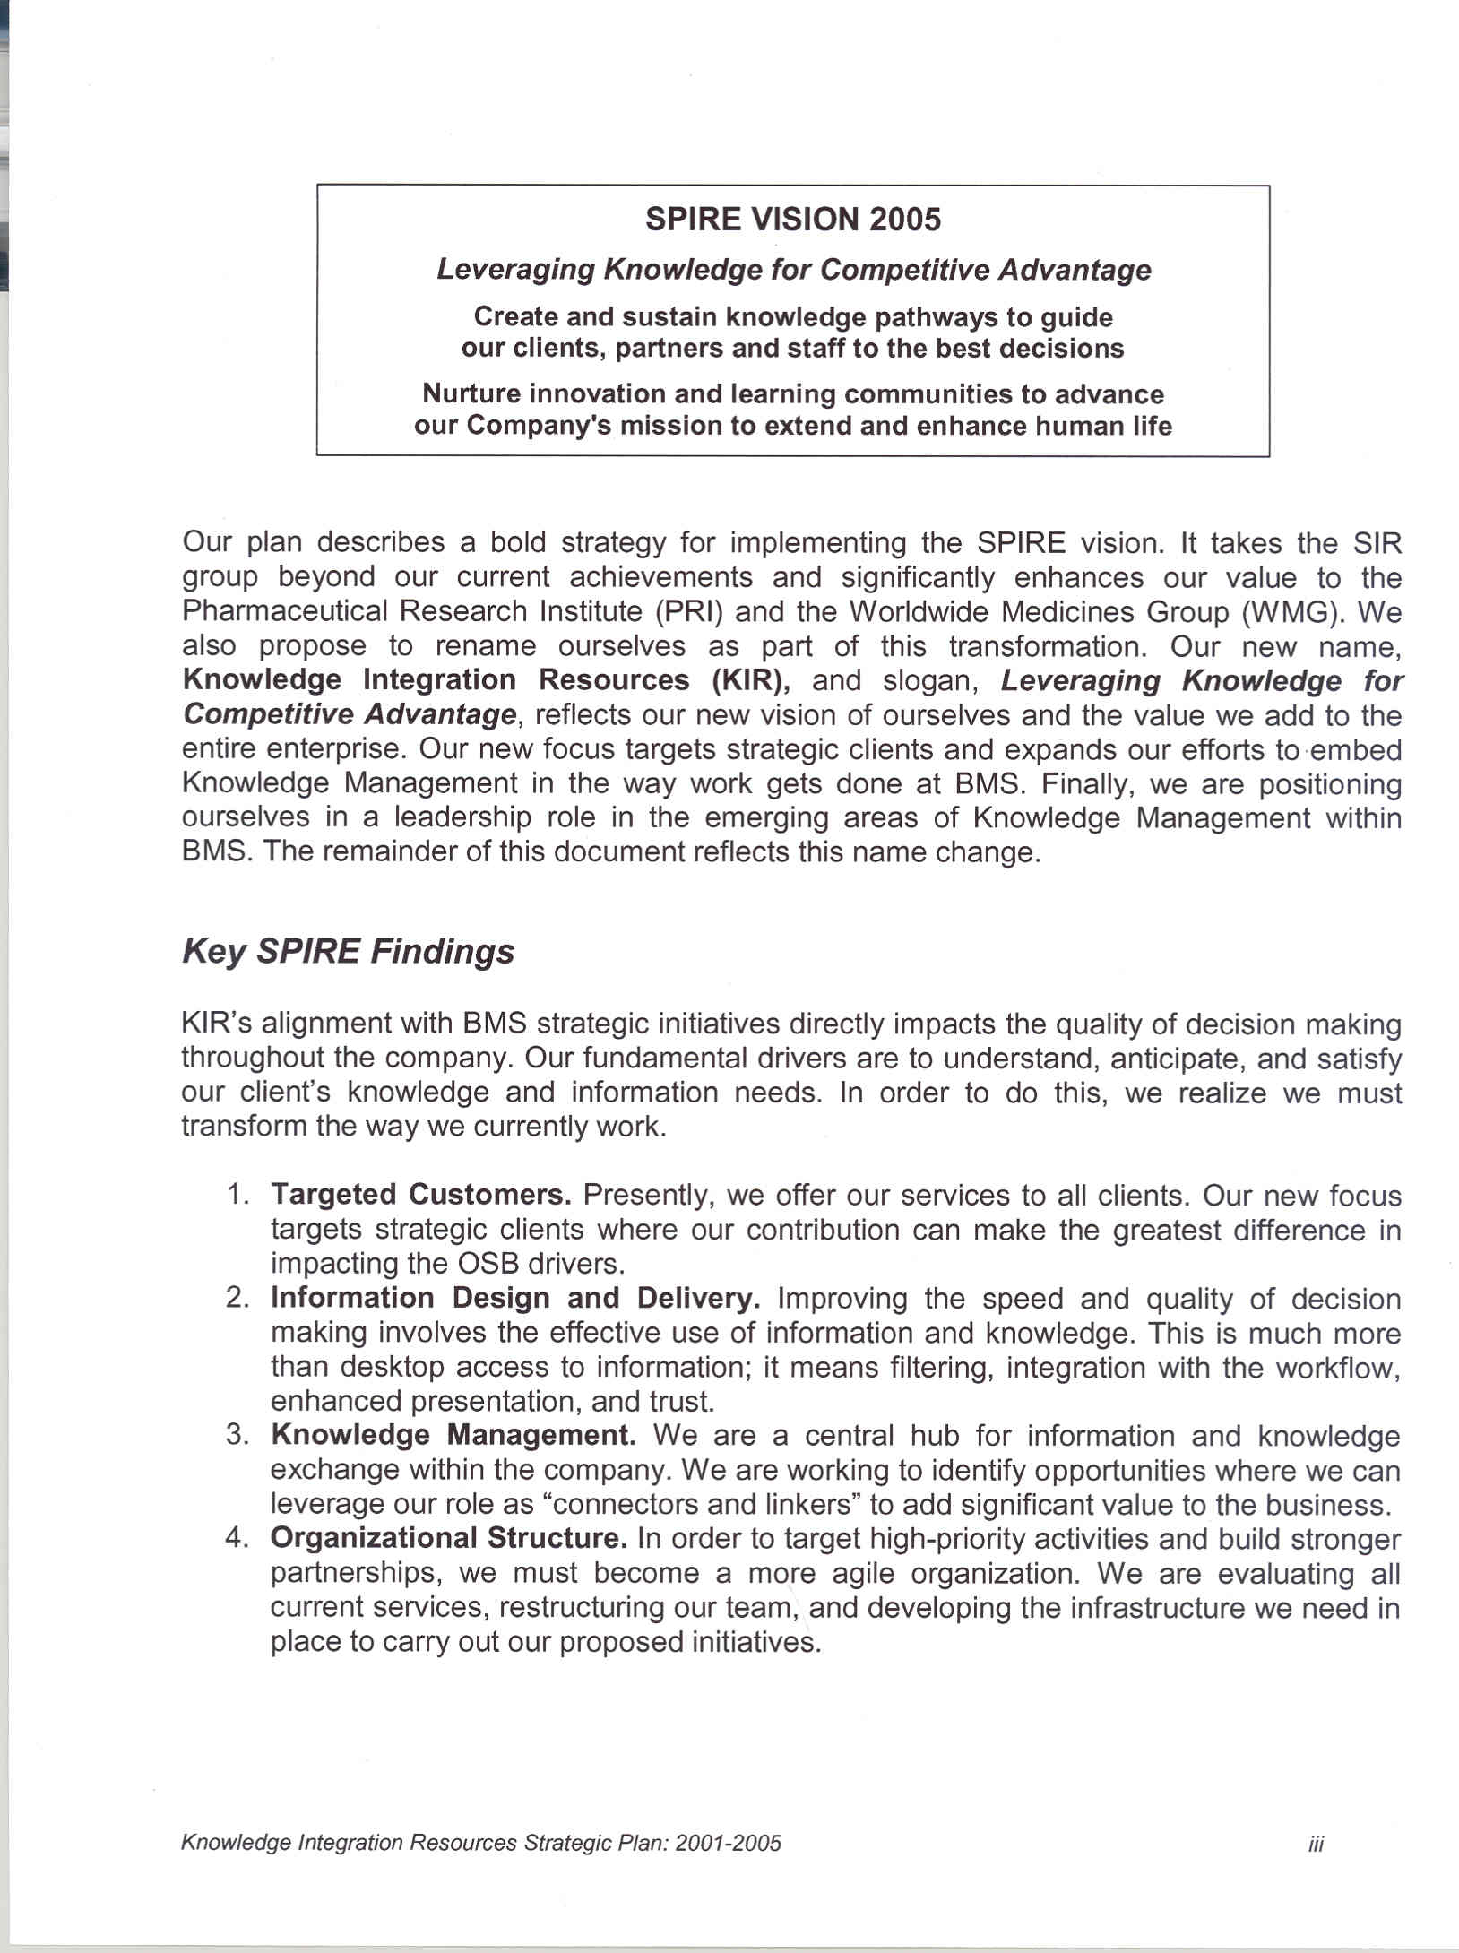
The Transformation of a Corporate Library
Original Strategic Planning Document

Slide 2
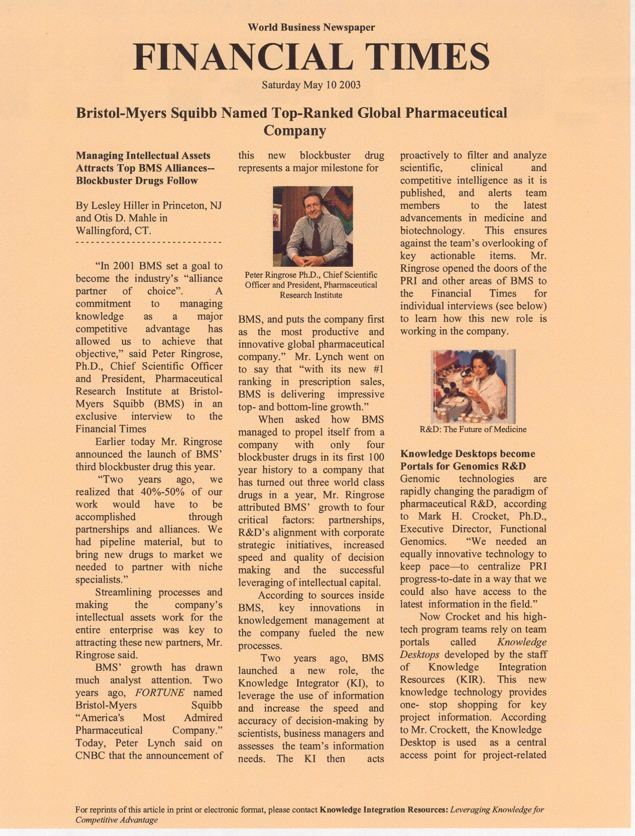
A Story that Leads People into the Future – 1st Edition
Developed into a compelling story for Senior Executives
Notes:
Script:
Telling a Story of the Future
For a long time, I had mixed success explaining what a Community of Practice is. I carefully drew the distinctions between a team, a work group and a community of practice. I used a definition consisting of words no greater than 2 syllables. I even made up a nifty graphic.
Now matter how I worded it, no matter how simple I tried to make it, in every group. Some people would get a glazed look. I had done everything I could think of and still wasn’t able to explain the concept to people.
In desperation, I stopped trying and started reading Steve Denning’s new book, The Springboard: How Storytelling Ignites Action in Knowledge Era Organizations.
There are many ways to tell a story and many ways to use them. The “springboard” has certain characteristics:
It is short and simple. Your goal is to spark understanding
It is told from the viewpoint of one individual in a predicament that is common in our business
The predicament is familiar to our audience
It’s the exact conundrum that KM is mean to solve
The story has an element of the unexpected
It has a happy ending
It is told orally. Human beings convey meaning through verbals

Slide 3
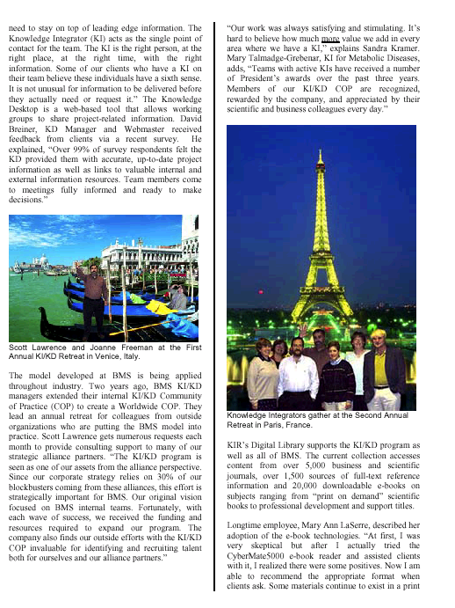
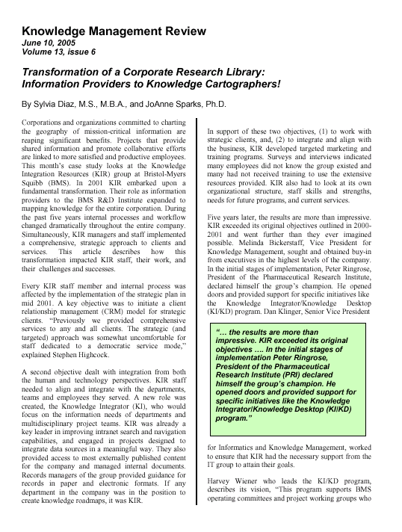
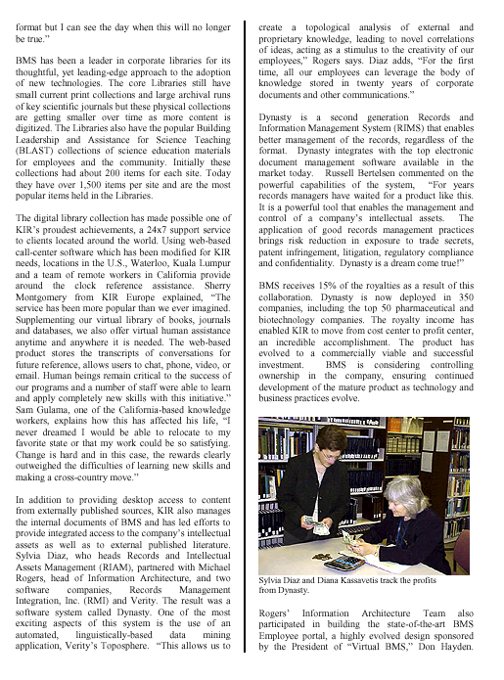
A Story that Leads People into the Future
Developed a second story “to enable staff members” to create a picture of their new roles
Notes:
Script for Slides # 2 & 3:
When you walk away from this session today, it is my hope that you will be able to actually explain knowledge management to someone else ,understand how Knowledge Management is linked to business value, understand the progress of Knowledge Management at our competitor pharmaceutical companies, understand how BMS is applying Knowledge Management for strategic advantage, and understand the potential future for BMS as a Knowledge-Centric organization.

